Slide 1
User Interfaces for
Embedded Systems
Presentation 3:
Interaction Devices

Slide 2
Agenda
Definition
  User Interface / Interaction Device
Which types of user interfaces are available?
  Pro’s & con’s, qualities & deficiencies
How to implement the user interfaces

Slide 3
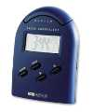

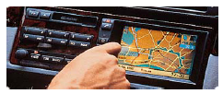
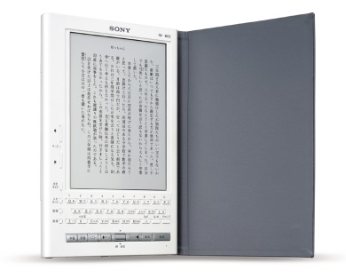
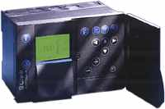
What is Meant by
”User Interfaces”?
A User Interface may have many definitions and meanings
Definition here: a means for a user to interact with a device
  Ranging from simple devices such as ”lamps”, where the interface might be a simple switch, to computer controlled devices with multiple optional interfaces
  This is sometimes also referred to as ”Interaction Devices” (Shneiderman)

Slide 4
High-level Interface Taxonomy I/III
Switches
  Used for many electrical & electronic low-level devices, e.g. lamps, hairdryers, coffee machines etc.
Buttons (one might argue that a switch is also a button or vice versa)
  Used with a wide range of interaction devices, including TV-sets, DVD-players, Microwave-owns and similar appliances.
Knobs
  Hi-Fi equipment, regulation and tuning, industrial use,
Soft buttons (a.k.a. soft keys)
  Used for multi-function button e.g. ”select” buttons on a cell phone
Keyboards & Keypads (Shneiderman, p. 348-358)
  A collection of relevant buttons, primary input device for PC’s (QWERTY) and cell phones (e.g. T9 based)

Slide 5
High-level Interface Taxonomy II/III
Classic Pointing Devices (Shneiderman, p. 358-362)
  Direct control devices: Lightpen, Touch screen, Stylus
  Indirect control devices: Mouse, Trackball, Joystick, Trackpoint, Touchpad, Graphics tablet
  Used mainly for PC’s and PDA’s.
Novel Pointing Devices / Geusture Recognition (Shneiderman, p. 362-365)
  Foot controls, Eye tracking, 3D trackers, DataGloves, Boom Chameleon, Haptic feedback, Bimanual input, Tangible user interfaces
Displays & Indicators (Shneiderman, p. 385 -395)
  Raster scan cahtode-ray tubes - CRTs, used for classic monitors and TV-screens
  Liquid-crystal Displays (LCD) used for all types of devices, including PC’s, TV-sets, cell phones etc.
  Plasma display panels (PDPs)
  Light-emitting diodes (LEDs), used for simple signaling with a single or few diodes, or in symphony as displays
  Electronic ink, maybe the future of newspapers?
  Braille displays (for blind users)
  Displays are the primary output method of most advanced devices

Slide 6
High-level Interface Taxonomy III/III
Touch screen
  A combination of input and output interface providing ”direct” interaction. Used for Information-kiosk systems, PDA’s etc.
  Handwriting recognition
Speech & Auditory Interfaces (Shneiderman p. 376-385)
  Sound is used extensively for feedback, both speech and sound effects
  Speech generation (artificial speech): used e.g. in GPS-based navigation systems (“turn right next”)
  Speech recognition is slowly gaining momentum in PC-based applications, and in a few other areas
Other types
  Virtual Reality (heads-up and helmet-mounted displays), Augmented Reality (Tangible), Ubiquitous/Pervasivce Computing & Implicit HCI (using e.g. RFID and other recognition methods), indirect HCI (using e.g. a browser interface to communicate with a device – e.g. routers), multimodal

Slide 7
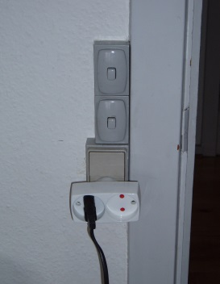
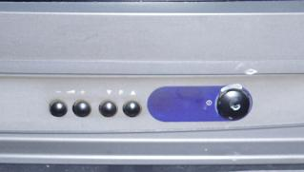
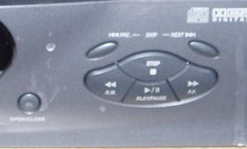
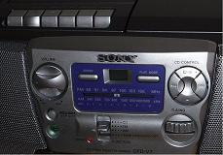
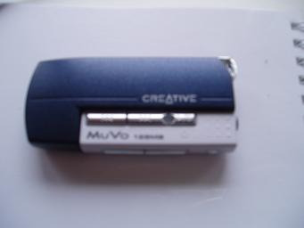
Switches, Buttons & Knobs
Simple electrical switches
Usage
  These basic & classic types of input devices are used throughout the electronic industry.
  Most GUI Widgets have digital representations as well: “virtual” buttons & knobs
Pro’s & con’s, qualities & deficiencies
  Easy to use – partly implicit feedback
  Accepted by general user convention
  Many functions => many buttons
  Many buttons may become confusing
  Cheap and easy to implement
  Only one function pr. button (attaching more than one function must be used with caution – often seen in calculators)
Switching on the
TV-set and
changing channels
Controlling a
DVD-player with
buttons
Controlling a
Multifunctional GB.
Mechanical buttons
for the tape; buttons
for the CD; knobs for
changing radio-
Stations. A LED display
provides feedback.
Using same button for
swiching on/off, pause
& playback provides
users with headache

Slide 8
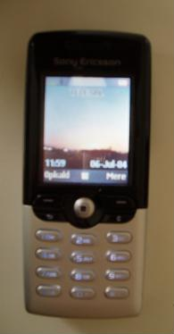
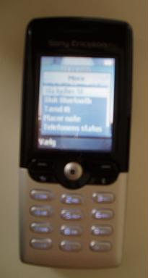
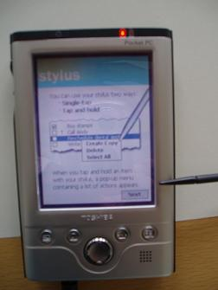
Soft Buttons (a.k.a. Soft Keys)
Usage
  Used in many high-tech devices – especially the cell phone industry
  Building on the “button” convention
  Used in conjunction with a display
  “Mapping” between display and hardware
  SDK’s provide widget support for soft buttons
Pro’s & con’s, qualities & deficiencies
  Has become a convention accepted by most users of electronic equipment
  Ideal for small devices with limited space for user interface
  Very nice solution to user interfaces with many transient tasks – e.g. cell phones, by reducing the cognitive load on the user in the current situation
  Potential problem with the “mapping” between the hardware button & the screen (indirect)
Soft buttons are used extensively in the cell phone industry and other devices with limited space for user interface elements
The soft buttons
adapts to the current
task, showing only the
relevant choices
needed for the
completion of the
current task
This Toshiba Pocket PC
also employs soft buttons
but these do not map
to buttons, but rather
depends on the touch
sensitive display

Slide 9
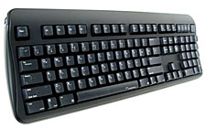

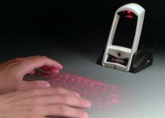
Keyboards & Keypads
A reduced keypad with 12 keys is used
along with the T9 system on this Sony Ericsson cell phone.
The keypad takes up half the space of the
device
Usage
  Used with many high-tech devices
  Primary interaction device for PC’s
  Amongst others: the QWERTY (used i.e. for PC’s) and the cell phone keypad
Pro’s & con’s, qualities & deficiencies
  Takes some time to master
  Easy mass data entry with QWERTY for experienced users, but even cell phone keypads are still faster than e.g. write recognition (with T9 anyways)
  Highly standardized (more than 100 years of QWERTY – the Sholes & Glidden, 1874)
  Takes up space
  Indirect operation
The standard
Sholes & Glidden
(“QWERTY”)
keyboard for a
modern PC
This Treo 600 PDA is
equipped with a full
QWERTY keyboard
The Canesta Keyboard
uses a tiny laser "pattern projector"
to project the image of a full-sized
keyboard onto a convenient
flat surface (www.canesta.com)

Slide 10
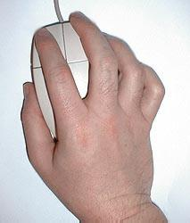
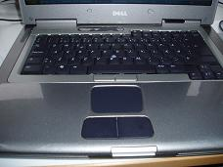
Classic Pointing Devices - Indirect
Usage
  Used with many high-tech devices
  Well-suited for complex interfaces
  Most widespread pointing device – the mouse, used primarily with PC’s
  Spreading to othaer areas where the interfaces are getting increasingly complex
Pro’s & con’s, qualities & deficiencies
  Low cost (mouse) interaction device
  Takes some time to master
  Intuitive to “point & click” – more natural for the human mind than menus & buttons
  The mouse is the most accurate and fastest pointing device
  Requires a lot of space (not including touch pads, joysticks & trackballs)
  Indirect operation is not intuitive
The “Mouse”. Invented by
Doug Engelbart in the early
1960’s (1963), at the
Stanford Research Institute.
Along with the QWERTY
keyboard the primary input
interaction device for most PCs.
Using a joystick for indirect navigation on this Sony Ericsson cell phone provides an alternative approach to the button/menu based phone navigation system
The Touch Pad is
an alternative to the mouse that requires only minimal space, ideal for laptop computers

Slide 11
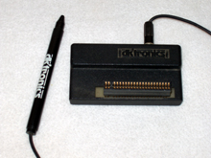
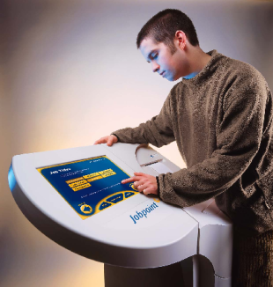
Classic Pointing Devices - Direct
The “Lightpen” was
invented in 1963
(same year as the
mouse) by
Ivan Sutherland. It proved
highly effective and
easy to learn, but was
not as effective as the
mouse, and much
more expensive.
Usage
  Lightpens used only with high-tech devices, most often PCs
  Touch Screens: well-suited for “walk-up and use” devices & devices with limited space (display & input device in one)
  Stylus used in conjunction with touch screens for precision performance
Pro’s & con’s, qualities & deficiencies
  Direct manipulation proven to be more natural and easier to learn than indirect (Shneiderman)
  Puts less strain on the mental model of the user, making it very suitable for ”walk-up and use” systems
  Operation is not as fast as with a mouse, especially for expert users
This Toshiba Pocket PC
employs a touch screen
for direct manipulation.
You can use the stylus,
a pen or your finger for
interacting with the user
interface. No additional
space is required, as it is
shared with the display.
Touch screens are
excellent for “walk-up
and use” systems.

Slide 12

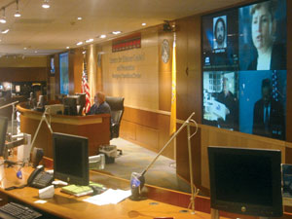

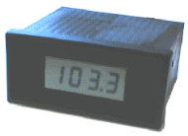

Displays & Indicators Usage
Displays are used as output media for all types of devices, ranging from simple LED-based status indicators to wall-sized displays with advanced GUI-features (like MS Windows widgets)
Technology available for manufacturing displays:
  Raster scan cahtode-ray tubes - CRTs, used for classic monitors and TV-screens. Not very suitable for appliances as they are big, bulky & heavy. Slowly they are disappearing from the PC-sector as well, being replaced by LCD
  Plasma display panels (PDPs) are better suited for mounted wall-sized displays than LCD as they are more bright and visible even from side locations. They currently have a higher energy consumption however
  Liquid-crystal Displays (LCD) used for all types of devices, including PC’s, TV-sets, calculators, cell phones etc., is now the predominant display technology because of their thin form, light weight and low electricity consumption
  Light-emitting diodes (LEDs), used for simple signaling (e.g. status indicators) with a single or a few diodes, or in symphony as displays. Once used extensively in calculators, digital watches and all kind of devices. This task is however now primarily solved by LCD displays. They are extremely cheap, easy to implement and use only a minimum of power (making them ideal for battery operated devices)
  Projector technology
  Electronic ink, maybe the future of newspapers, black & white displays that does not use energy to maintain a text or picture, only on the update
  Braille displays (for blind users)
CDC’s control room
with plasma screens
Green = playing
Red = paused
None = off

Slide 13
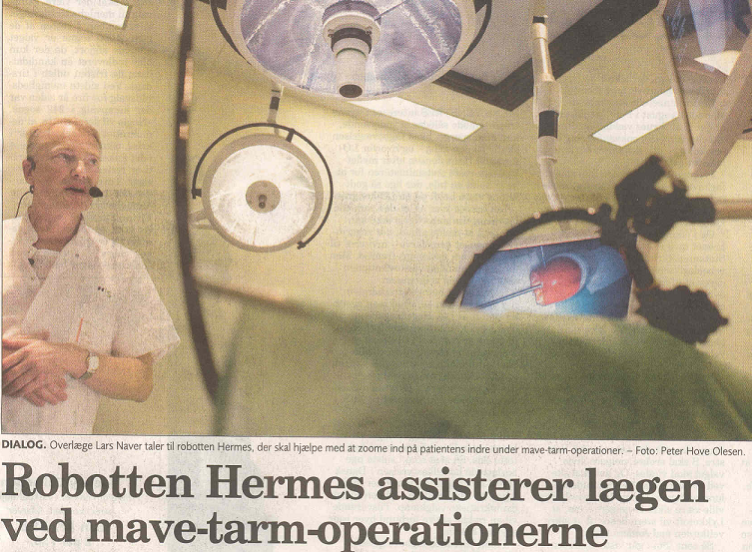
Speech & Auditory Interfaces
Usage
  Sound is used extensively for feedback, both speech and sound effects along with other interaction devices
  When users have vision/movement impairments, users with hands or eyes occupied with other tasks, or if cramped/harsh conditions makes other input devices inappropriate
  Speech generation (artificial speech): used e.g. in GPS-based navigation systems (“turn right next”)
  Speech recognition is only slowly gaining acceptance
Pro’s & con’s, qualities & deficiencies
  Speech recognition is only slowly gaining acceptance, and quality is still not acceptable for many applications
  Takes up no space on device (appliances can be made very small) and does not require the use of hands nor eyes for operation, that is, no direct contact
  Slow pace of speech output when compared to visual displays (we read faster than we listen)
  Interference from noisy environments (e.g. a Bus stop or Pig pen) renders devices unusable
  Unstable recognition across changing environments, users and time

Slide 14
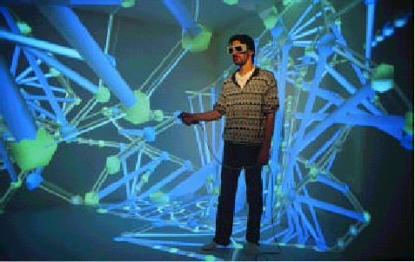

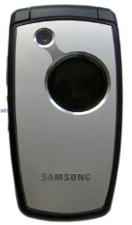

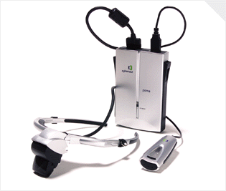

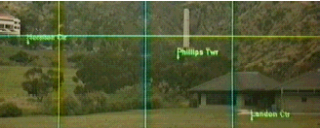
Virtual & Augmented Reality
Usage
  Since the early 60’
  Immersive technology
  Caves or glasses/helmets
  Visualization and training purposes
  Variant: see-through-displays – used as a always present HUD feature – “Augmented Reality”
  Gesture Recognition now used in mobile phones
Pro’s & con’s, qualities & deficiencies
  Immersive technology – maximizes humans 3D understanding of the world
  No established conventions yet
  Not good as a user interface in eg a car or similar (does not hold true for AR)
Six-sided CAVE (1998)
Pumo 2003 - $1500

Slide 15
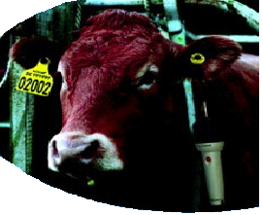
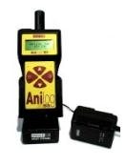
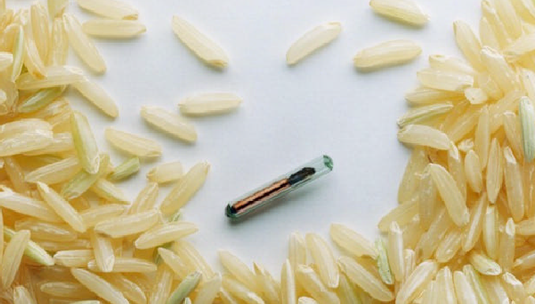
Implicit HCI / Context Awareness
Not really an interface
Usage
  The user does not have to interact – the device does the thinking for him
  One of the Fundamental ideas behind Pervasive & Ubiquitous computing

Slide 16
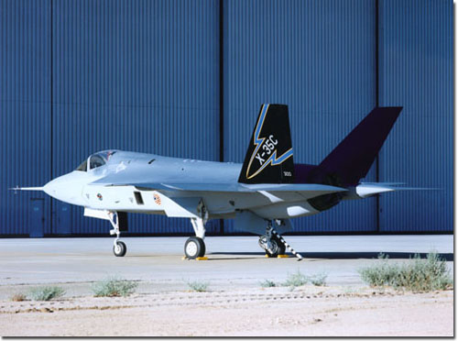
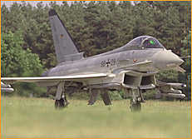
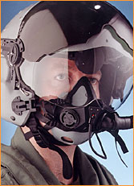
Multimodal Interaction Devices
Many appliances makes use of several interaction devices
As an example both the EuroFighter and the Joint Strike Fighter project relies on a multimodal user interface, including:
  Traditional ”joystick” controls
  Panel keyboard control
  Magnetic Head Tracker
  360° X-Ray Vision Helmet (virtual reality being tested)
  360° HUD display
  3D audio com & warning sound system
  Speech recognition software

Slide 17
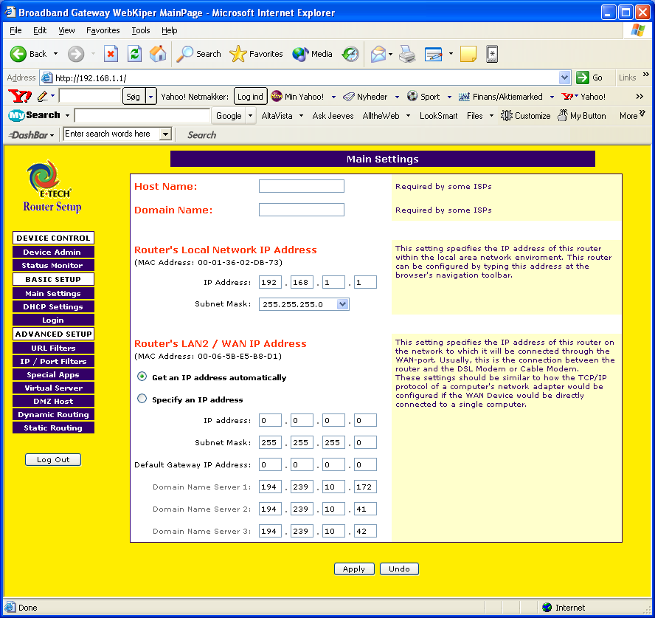
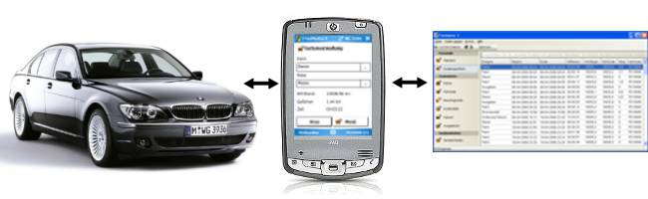

Distributed User Interfaces
Taking advantage of another device’s GUI features
Routers, Printers
Wired & Wireless
Rich & Thin Clients
Research Projects:
  SmartScreens
  Web-of-Technologies

Slide 18
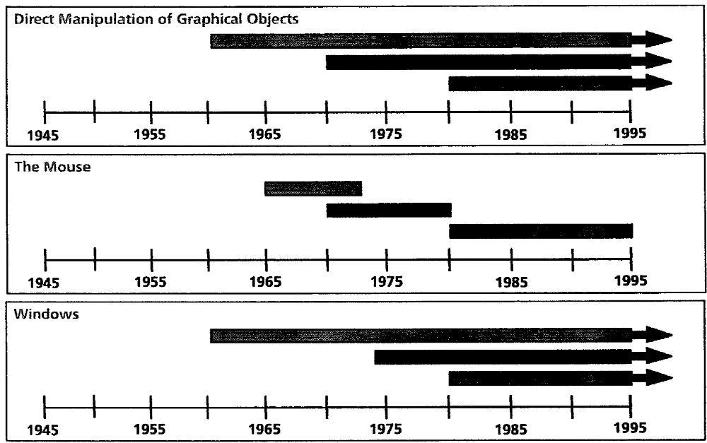
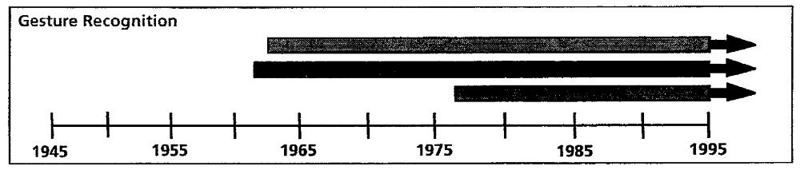
Future Interaction Devices?
Look out for research being done
Top: University Research
Middle: Corporate Research
Bottom: Commercial Development

